Slide 1
Project Management for IT ITM 471/571 Closing a Project
Kathy Kotowski
School of Applied Technology
Fall 2016

Slide 2
Summary of Chapter 8
Ch08: How to Close a TPM Project
Getting client acceptance
Installing project deliverables
Conducting the post-implementation audit
Writing the final report
Celebrating success
Notes:
Explain how each of these contributes to the growing importance of project management in the business world.

Slide 3
Are We There Yet?
The project is done when(choose one):
You deliver the deliverable and the customer accepts it
The stakeholders agree to end it
Never, it will go on forever!
It fails (and everyone admits it)
It’s cancelled (due to outside influences)
The ability to accurately assess the state of the project is key

Slide 4
Ch08: How to Close a Project
Why Do I Need Client Acceptance Procedures?
Acceptance criteria must be clearly defined
Criteria defined during project planning
Avoid 11th hour disputes

Slide 5
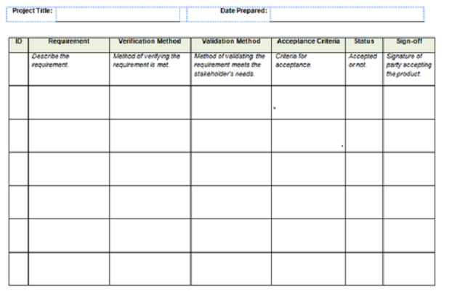
Sample acceptance checklist

Slide 6
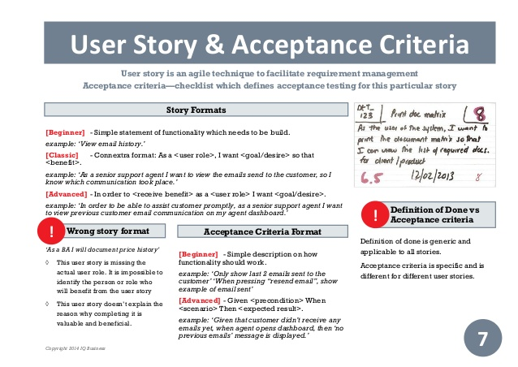

Slide 7
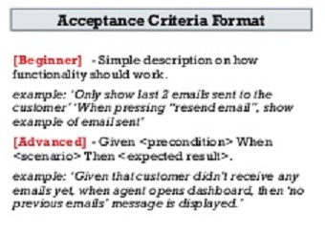

Slide 8
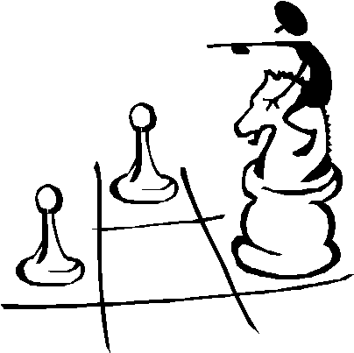
Ch08: How to Close a Project
Installing Project Deliverables
Cut-Over (direct) Approach
Parallel Approach
Phased Approach
By Business Unit Approach

Slide 9
Installation
After development and testing, system must be put into operation
Important planning considerations
Costs of operating both systems in parallel
Detecting and correcting errors in new system
Potentially disrupting the company and IS operations
Training personnel and customers with new procedures

Slide 10
Direct Installation
New system installed and quickly made operational
Overlapping systems turned off
Both systems concurrent for brief time
Advantage – simplicity and fewer logistics issues to manage
Disadvantage – risk due to no backup

Slide 11
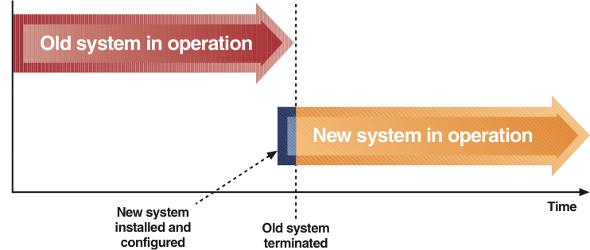
Direct Installation and Cutover

Slide 12
Parallel Installation
Old and new systems operated together for extended period of time
Advantages – low risk of system failure and continual backup
Disadvantage – cost to operate both systems
Hiring temporary personnel
Acquiring extra space
Increasing managerial and logistical complexity

Slide 13
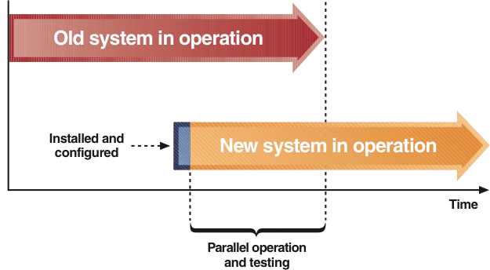
Parallel Installation and Operation

Slide 14
Phased Installation
New system installed in series of steps or phases
Each phase adds components to existing system
Advantage – reduces risk because phase failure is less serious than system failure
Disadvantage – multiple phases cause more activities, milestones, and management complexity for entire effort

Slide 15
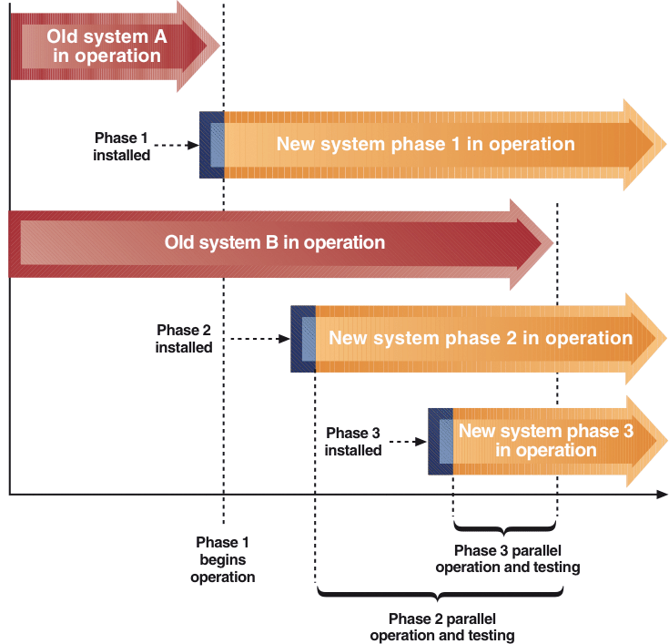
Phased Installation with Direct Cutover and Parallel Operation

Slide 16
By business-unit Installation
New system installed for certain portions of the company or specified trial locations
Advantages?
Disadvantages?

Slide 17
Audit (Team project assessment)
Audit goals
Identify the successes and failures
Gain an understanding of why (root causes)
Learn and record the knowledge
The process
Start with objective actual vs. planned data, then supplement with testimonials
Identify significant goods and bads
Do the detective work to determine the true sources
Record the lessons learned for future improvement

Slide 18
Keys to an Effective Audit
It’s not about blame
Chances are it was more process than person anyway
Focus on the big items
Chances are solving them will probably correct the little ones anyway
Try to balance positives and negatives
No project is all good or all bad
You can learn as much from your successes
Get a good scribe

Slide 19
Questions to Address
Did the team follow the plan?
Was the schedule appropriate? budget?
Did the PM lead effectively? manage?
Was the team cohesive and effective?
Did we have the right people? tools? training?, etc.
Was risk managed well? change?
Was communication proactive?
Were we able to do it right?

Slide 20
Evaluating Performance
Start with teams, then look at individuals
Gather feedback from multiple sources
Be objective, fact-based, honest and just
Keep true to the accountabilities established during planning
Emphasize successes and areas in need of improvement
Reward those who made it happen

Slide 21
Ch08: How to Close a Project
Audit – more questions
Was the project goal achieved?
Does it do what project team said it would?
Does it do what client said it would?
Was the project work done on time, within budget, and according to specification?
Was the client satisfied with the project results?
Was business value realized?
Check success criteria
What lessons were learned about your project management methodology?
How well did the team follow the methodology?

Slide 22
Ch08: How to Close a Project
Reasons for not doing a post-implementation audit
Managers don’t want to know
Managers don’t want to pay the cost
It’s not a high priority
There’s too much other scheduled work to do

Slide 23
Ch08: How to Close a Project
Documenting the Project
Reference for future changes in deliverables
Historical record for estimating duration and cost on future projects, activities and tasks
Training resource for new project managers
Input for further training and development of the project team
Input for performance evaluation by the functional managers of the project team members

Slide 24
Ch08: How to Close a Project
Documenting the Project – The Project Notebook
POS
Proposal and backup data
Original and revised project schedules
Minutes of all project team meetings
Copies of all status reports
Design documents
Copies of all change notices
Copies of all written communications
Outstanding issues reports
Final report
Sample deliverables (if appropriate)
Client acceptance documents
Post-implementation audit report

Slide 25
Ch08: How to Close a Project
Final Project Report (ITM 571: include this in Case studies)
Executive Summary
Overall success and performance of project
Organization and administration of project
Techniques used to accomplish results
Strengths and weaknesses of the approach
Recommendations
Appendices
POS
WBS
Resource Schedule
Change Requests
Final Deliverables
Other

Slide 26
Where Do We Go From Here?
Celebrate success, or at least the accomplishment of completion
Respect the team’s momentum and comfort with each other
Look for opportunities to advance individuals
Relax, reflect and refresh
Do it again - only this time do it better!

